Slide 1

FCRPS Fish Passage – turbine tables Update
January 13, 2022
Dan Patla, P.E., Chief of Turbine Section, HDC
Joe Van Winkle, P.E., Turbine Section Engineer
Jim Alders, Bonneville Power Administration

Slide 2
Background
As part of the grid modernization effort testing was done to ensure turbine controls were functioning properly and tables represented the energy output correctly.
HDC used that data to develop new more accurate flow tables for the USACE hydro units in the FCRPS Mainstem Columbia, Lower Snake, and Headwater projects.
What’s changing:
  FPP – 1% Tables
  GDACS – Flow Tables, Cavitation Limits
  Cam Curves – Digital Governor Inputs

Slide 3
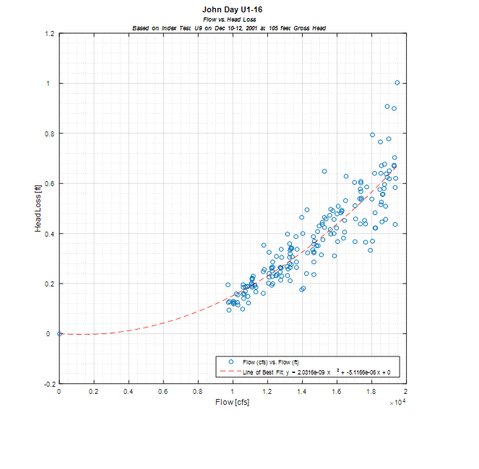
Head Loss in turbine operating tables
Old Flow Table Methodology – Assume that there is no head loss.
New Flow Table Methodology – Account for head loss.

Slide 4
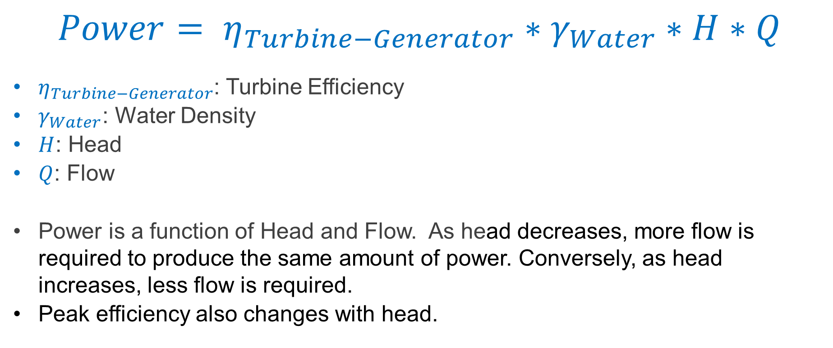
Turbine Operation
$$Power= η_{Turbine−Generator}∗γ_{Water}∗H∗Q$$
$η_{Turbine−Generator}$: Turbine Efficiency
$γ_{Water}$: Water Density
$H$: Head
$Q$: Flow
Power is a function of Head and Flow. As head decreases, more flow is required to produce the same amount of power. Conversely, as head increases, less flow is required.
Peak efficiency also changes with head.

Slide 5
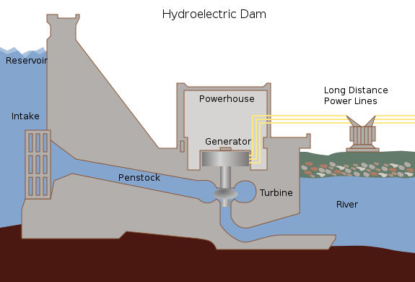
Head Discussion
Gross Head – Defined as the water elevation of the Forebay minus the water elevation of the Tailrace.
Net Head – Head available at the turbine after losses due to friction, turbulence, etc. are removed. (Net Head < Gross Head)
Gross Head
Net Head

Slide 6
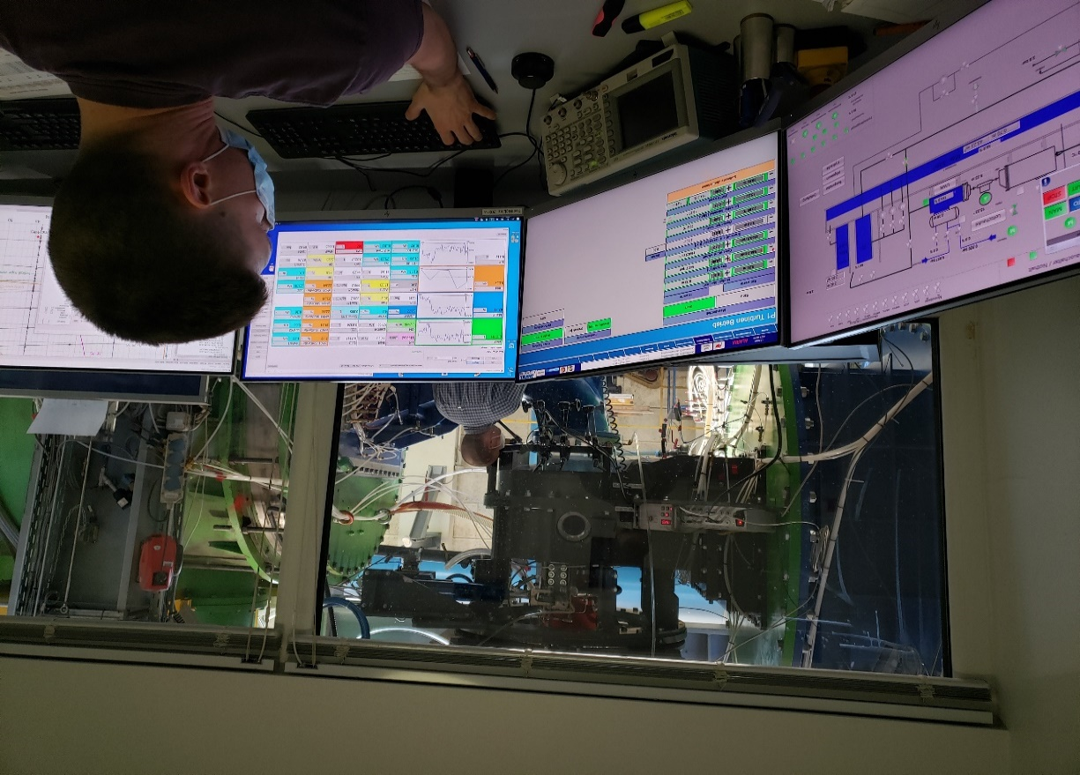
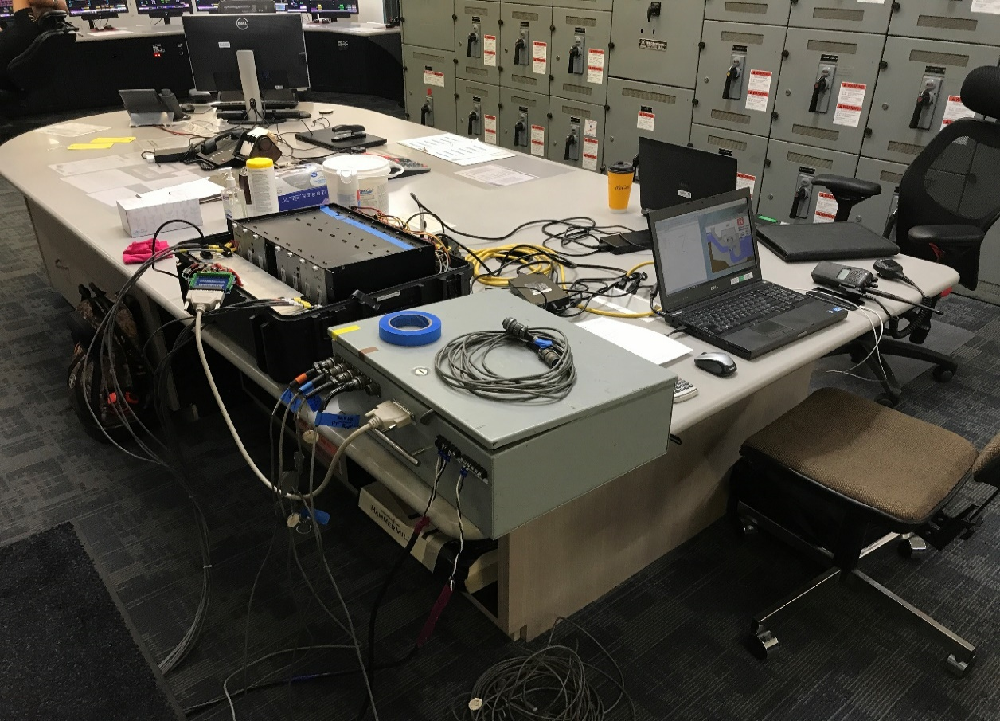
Inputs to flow table development:
Model Test and Index Test
Model tests are completed on a scaled basis in a laboratory setting. Model tests enable testing to be completed at various heads to monitor effects on turbine efficiency.
Index tests are field measurements of power, head, and relative flow. Results are normalized to one head.

Slide 7
Incorporation of Model and Index Tests
Old Methodology – shift results at all heads, using a constant change. Index test is main driver in development of tables, where the model test is a much smaller driver.
New Methodology – weight results to proximity; heads closer to the index test head weigh more heavily on index test results, heads further from the index test head weigh more heavily on the model test. The use of both index and model tests are more balanced in development of the tables.

Slide 8
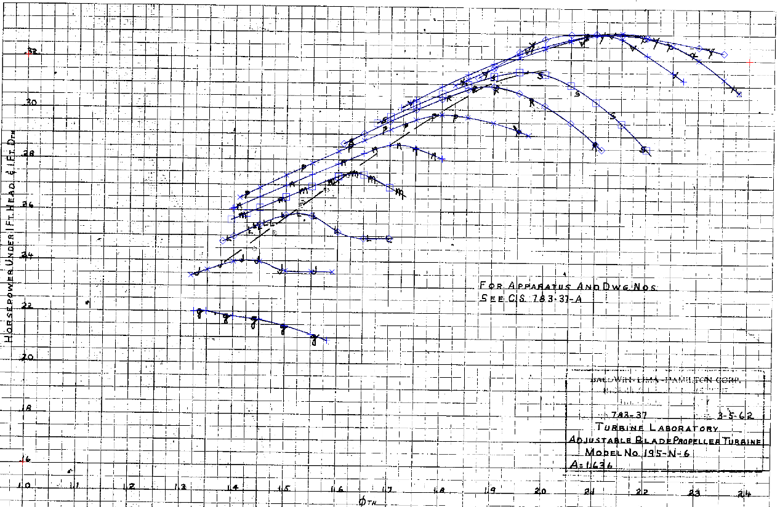
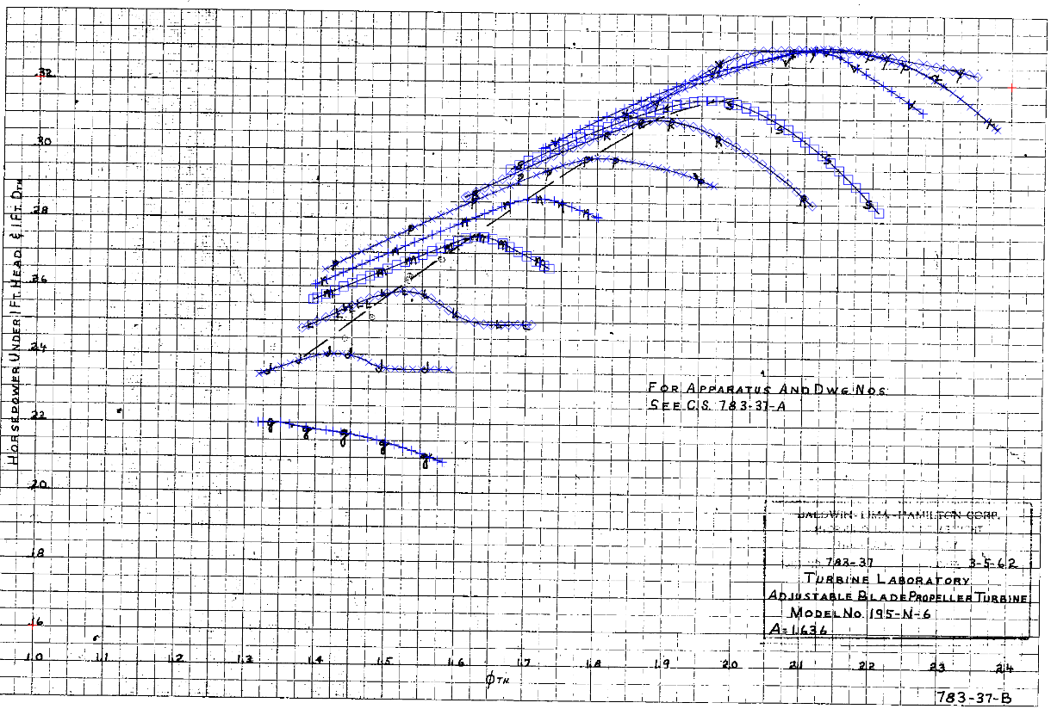
Incorporation of Index Tests
Old Method – Use a pen, paper and scale for data analysis and interpretation of the test results.
New Method – Uses computational tools for data analysis and interpretation of the test results.

Slide 9
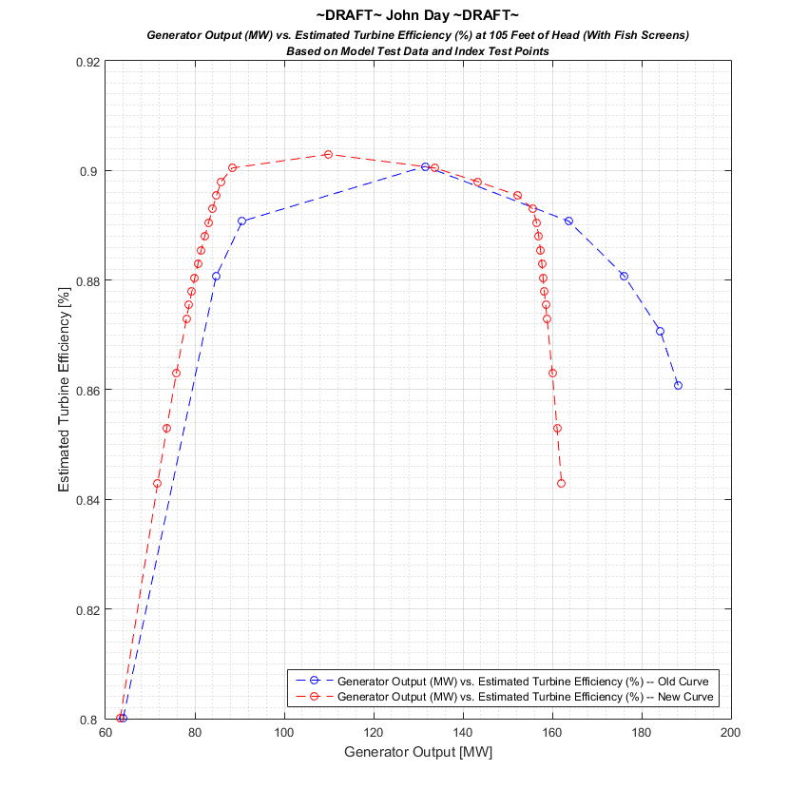
Example: Side-by-Side Comparison (John Day)
New 1% Efficiency Envelope
Old 1% Efficiency Envelope

Slide 10
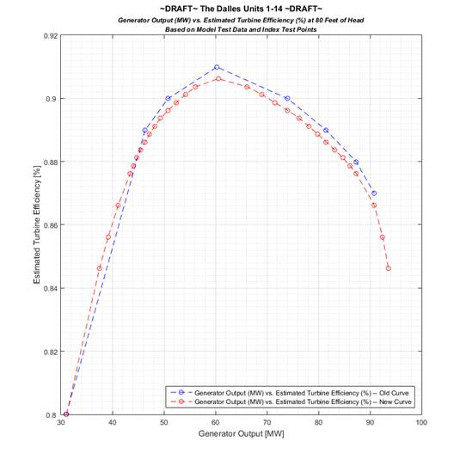
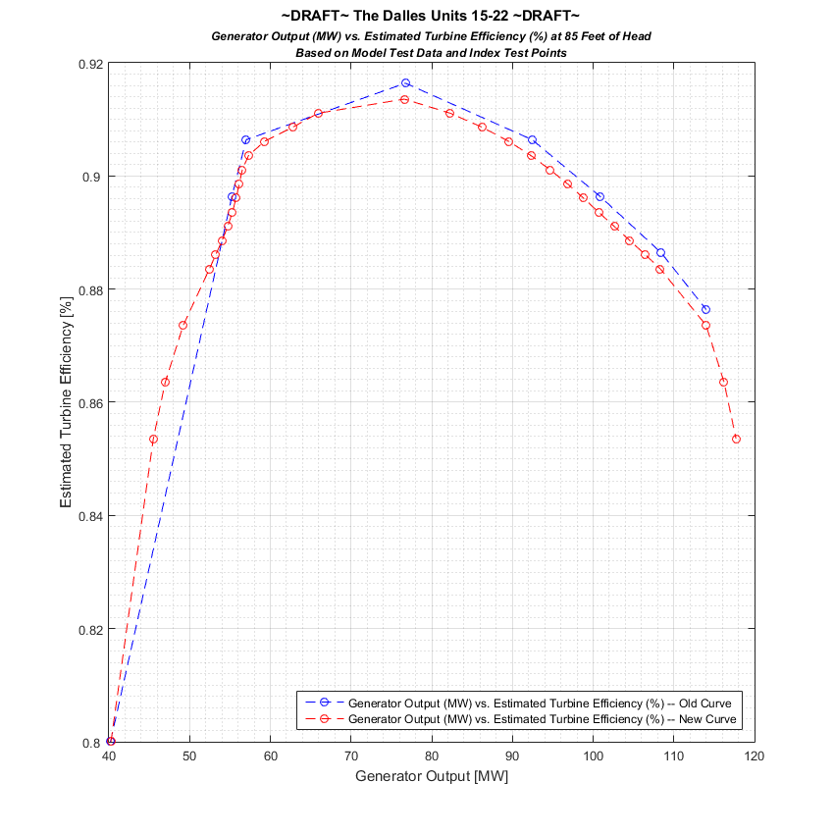
Example: Side-by-Side Comparison (The Dalles)
New 1% Efficiency Envelope
Old 1% Efficiency Envelope

Slide 11
Example: 1% Efficiency Envelope as head changes
John Day
New methodology results in changes to assumed turbine efficiency and 1% turbine limits defined in the fish passage plan. Example of shift for John Day below:
Generator Limit at 155MW
Typical head operations between 96 and 106 feet

Slide 12
Example: 1% Efficiency Envelope as head changes the Dalles
New methodology results in changes to assumed turbine efficiency and 1% turbine limits defined in the fish passage plan. Example of shift for The Dalles below:
Generator Limit at 90MW
Typical head operations between 75 and 85 feet

Slide 13
Future Actions
Index Test completed at John Day – week of 30 November. Index test analysis complete and incorporated into tables in the February timeframe.
New table development underway for Bonneville and Lower Snakes.
Completed to date are John Day and The Dalles.
HDC will transmit new 1% limits to NWD for incorporation into FPP – February/March.
McNary is planned for deployment mid-year 2022.
Deploy: prior to fish passage season 2022 (April 3/10)

